Slide 1
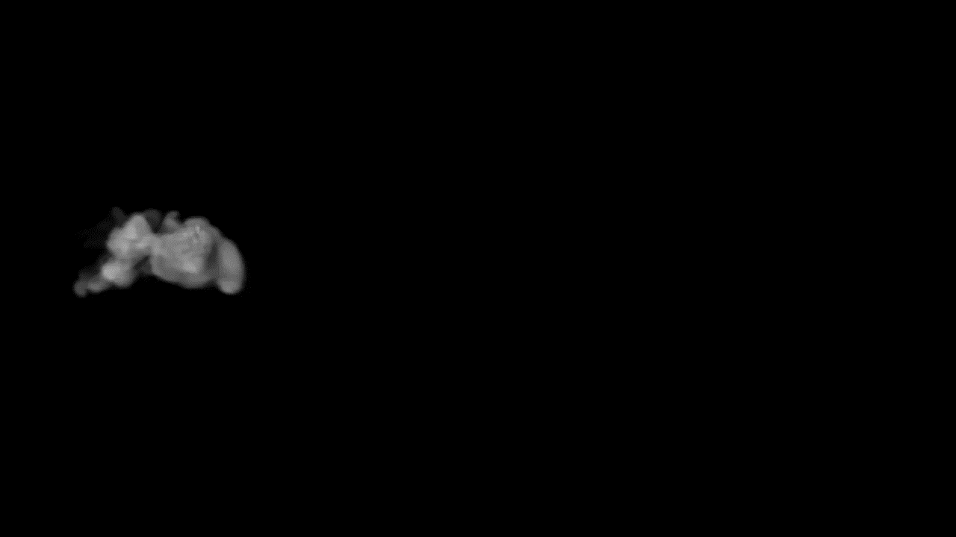


W
L
E
M
WELCOME
E
O
C

Slide 2
TEAM MEMBERS
Shivani Kashamolla
Zahoor Ali Sheikh
Vasudha Warwatkar
Sumanth
Reddy
Jalendra MB
Manish Thakur

Slide 3
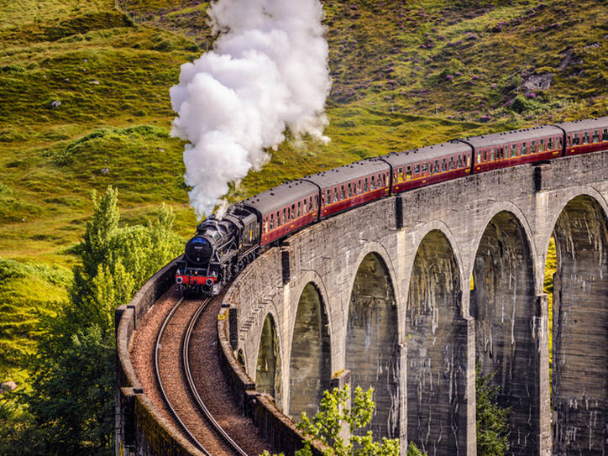
TRAIN TICKET BOOKING SYSTEM

Slide 4
CONTENTS
RESULTS
DESIGN
TECHNOLOGY
PROBLEM STATEMENT

Slide 5
Problem Statement
This Project is to give efficient software to reserve, cancel and review the railway tickets .
The users can create account for login the system and booking any train tickets quickly.
The Administrator should have the ability to perform operations like add a new train, modify the ticket costs and cancel a particular train.
This system is extremely easy to use which resulting in time and efficiency due to that it saves a lot of time of user.

Slide 6
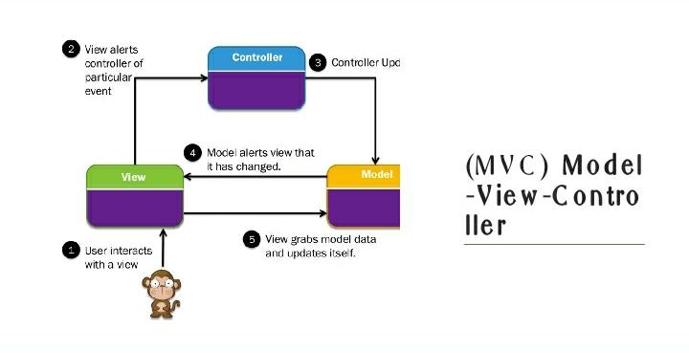
DESIGN

Slide 7






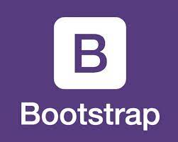
TECHNOLOGY

Slide 8
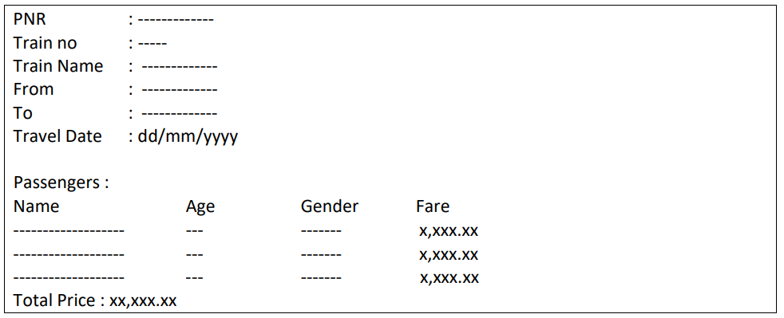
Results
The Ticket details should be stored in a file as per below format. The passenger’s should written in ascending order based on name.

Slide 9
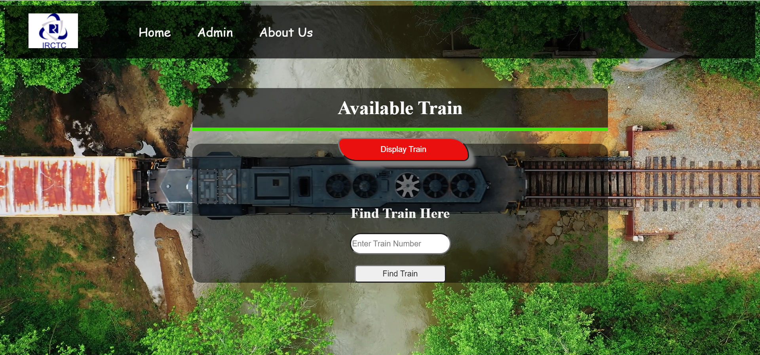
Results

Slide 10
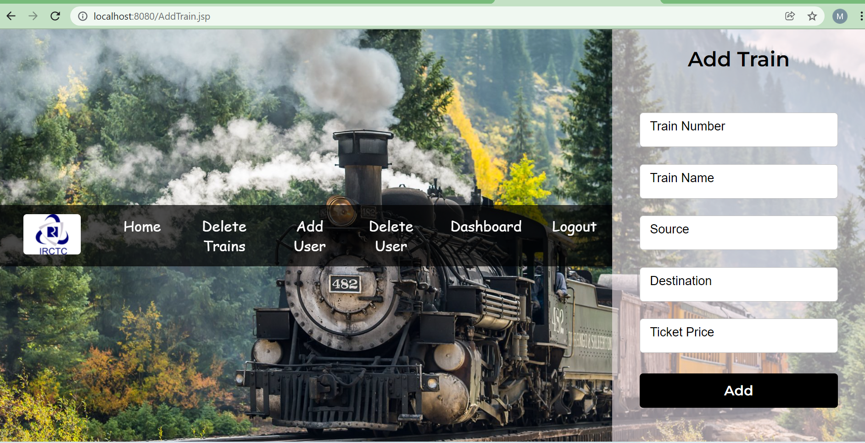

Slide 11
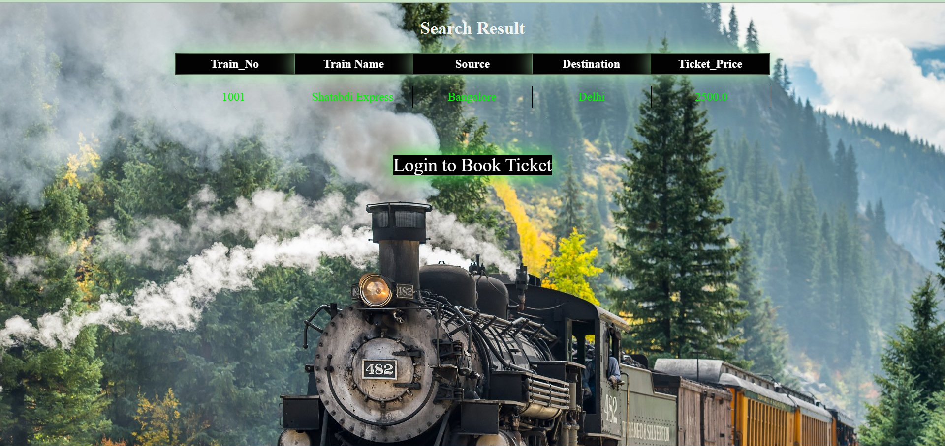

Slide 12
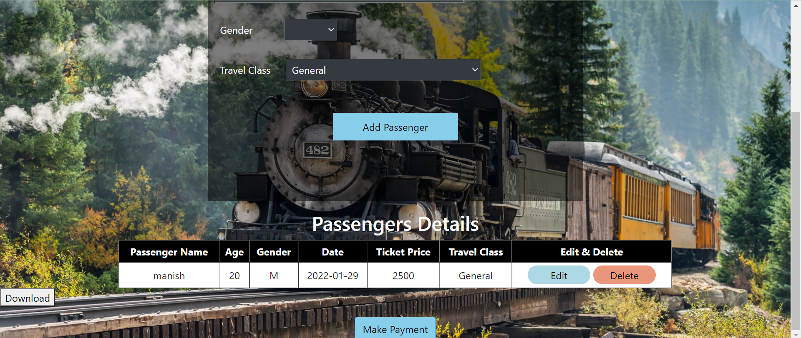

Slide 13


